Slide 1
Top 10 Tips for Getting a 5 on the AP Statistics Exam
Daren Starnes
The Lawrenceville School
dstarnes@lawrenceville.org
East Kentwood High School
January 2014

Slide 2
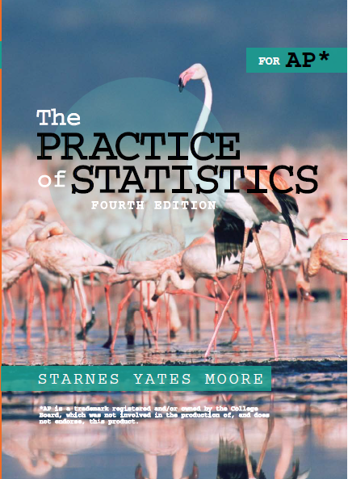
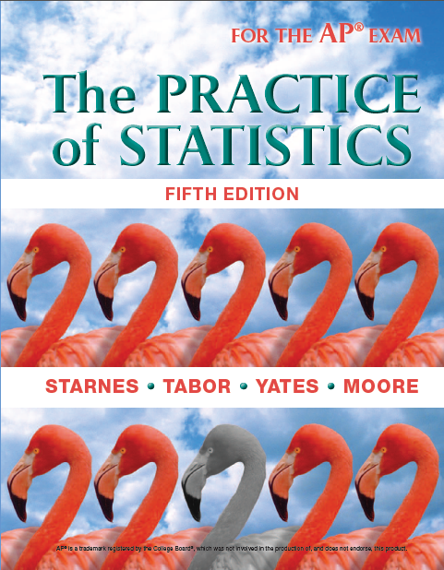
Why flamingos?
They look cool!
Statistics is the study of variation
One stands out

Slide 3

#10. You gotta talk the talk

Slide 4
#9. Know the score
Multiple choice: 50 points possible
  1.25 points for each correct answer
  Answer all the questions! (No guessing penalty)
Free response: 50 points possible
  0 to 4 on each question
  Score on Q1 – Q5 multiplied by 1.875 (37.5 pts)
  Score on Q6 multiplied by 3.125 (12.5 pts)
How many points to get a…?
  In 2012, 70 → 5, 57 → 4, 44 → 3, 33 → 2

Slide 5
#8. Be smart with technology
Don’t type in data just because it’s there!
Calculator speak = no full credit
(1) Binompdf(12,.2,3) = no full credit
Better: P(X = 3) = (12C3)(0.2)³(0.8)⁹
Minimal: binompdf(n = 12, p = .2, k = 3)
(2) Normalcdf(90,105,100,5) = no full credit
Better: Find z score. Then draw, label, shade Normal curve, and find the area.
Minimal: normalcdf(lower bound = 90, upper bound = 105, mean = 100, std. dev. = 5)

Slide 6
#7. Pace yourself
Multiple choice section 40 questions, 90 minutes
  Don’t spend too long on any question
  They are all worth the same amount!
Free response section 6 questions, 90 minutes
  Don’t run out of time before Question 6!!
  Start with questions you feel confident about

Slide 7
#6. Follow the 4-step inference process

Slide 8
#5. Naked answer = no credit
Directions: Show all your work. Indicate clearly the methods you use, because you will be graded on the correctness of your methods as well as on the accuracy and completeness of your results and explanations.

Slide 9
#4. Don’t write too much!
Less is more…
Answer the question, then shut up☺!
Space provided is more than enough
Avoid parallel solutions

Slide 10
#3. Listen to your teacher
Mr. Wilcox knows his stuff
He grades the exams
His students get high scores
Plus he’s really cool☺
No, I didn’t add that last one just because he invited me to dinner tonight

Slide 11
#2. RTQ & ATQ!!
If a question asks you to
  Describe a distribution (Shape, Center, Spread)
  Compare distributions (higher or lower center, more or less variability)
  Describe similarities and differences
  Explain or justify
  Do more than one thing, eg find the mean and standard deviation…

Slide 12
#1. Be Prepared!
Know your stuff
Review Formulas and Tables for AP Exam
Do lots of practice AP questions
  Multiple choice
  Free response
Work to eliminate any weak spots and build your confidence

Slide 13
AP Statistics Exam Tips
Recap
#10. You gotta talk the talk
#9. Know the score
#8. Be smart with technology
#7. Pace yourself
#6. Follow the 4-step inference process
#5. Naked answer = no credit
#4. Don’t write too much!
#3. Listen to your teacher
#2. RTQ & ATQ!!
#1. Be Prepared

Slide 14

Questions about the AP Exam or The Practice of Statistics?

