Slide 1

Experience First, Formalize Later: Reimagine Calculus Class
Sarah Stecher

Slide 2

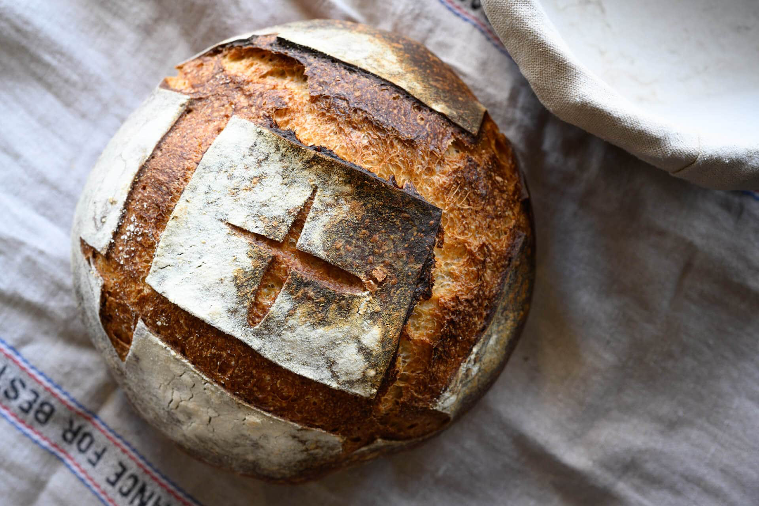




Slide 3
LEARNING TARGETS FOR THE WORKSHOP
Unpack our beliefs about what a Calculus class should look like, sound like, feel like
Discuss how teaching with the EFFL model can disrupt problematic assumptions about learning Calculus

Slide 4
What does your ideal classroom look like?
What are students doing?
What is the teacher doing?
What norms are in place?

Slide 5
Core Beliefs
All students are capable of doing authentic mathematics.
Students construct understanding through discussion and collaboration.
Math instruction should focus on building conceptual understanding, not mimicking procedures.

Slide 6
What do beliefs have to do with it?
v
Tasks
Beliefs
Teacher moves
Student experience
Class norms

Slide 7
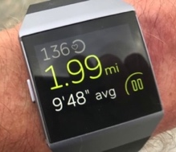
Pamela’s Run
Learning Targets
Interpret average rate of change and instantaneous rate of change contextually and graphically.
Estimate instantaneous rate of change by calculating the average rate of change over a short interval.

Slide 8
Reflection
Group 1: How did the task support the core beliefs?
Group 2: How did the teaching moves support the core beliefs?
Beliefs
All students are capable of doing authentic mathematics.
Students construct understanding through discussion and collaboration.
Math instruction should focus on building conceptual understanding, not mimicking procedures.

Slide 9

Under Cover
Learning Targets
Interpret the meaning of the independent and dependent variables of accumulation functions.
Apply the FTC to find the derivative of an accumulation function.

Slide 10
Reflection
Group 1: How did the teaching moves support the core beliefs?
Group 2: How did the task support the core beliefs?
Beliefs
All students are capable of doing authentic mathematics.
Students construct understanding through discussion and collaboration.
Math instruction should focus on building conceptual understanding, not mimicking procedures.

Slide 11
What’s your biggest take-away?
Sticky note share-out.

Slide 12
Contact Info
Sarah Stecher
sarah@calc-medic.com
All resources can be found at Calc-medic.com

